Slide 1

Applied Physics
(Computer Science Department)
Rectifier
Half Wave Rectifier
Full Wave Rectifier
By: Mushtaque Ali
&
Saqib Hussain

Slide 2
Rectifier
Rectifier
A rectifier is an electronic device used to convert alternating current (AC) into direct current (DC).
This process is known as rectification.
A rectifier, consists of a transformer, a diode, and a filter circuit. All of these collectively convert AC to DC.

Slide 3
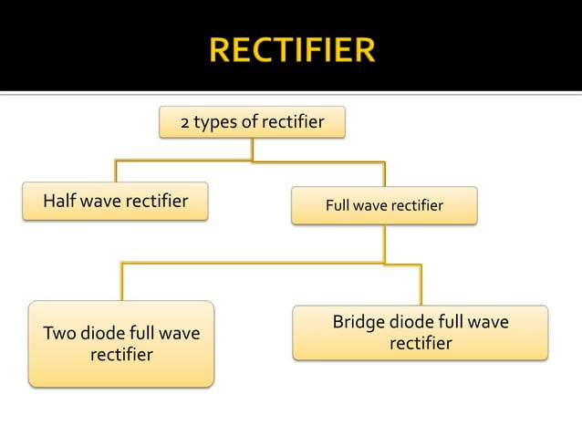
Applied Physics
(Computer Science Department)

Slide 4
Half-wave rectifier
Half-wave rectifier:
A rectifier that converts alternating current (AC) into direct current (DC) by allowing current flow in only one direction during half of the AC cycle, using a single diode.
In Half wave rectification, the rectifier conducts current during positive half cycle of input AC signal only.
Negative half cycle is suppressed.

Slide 5
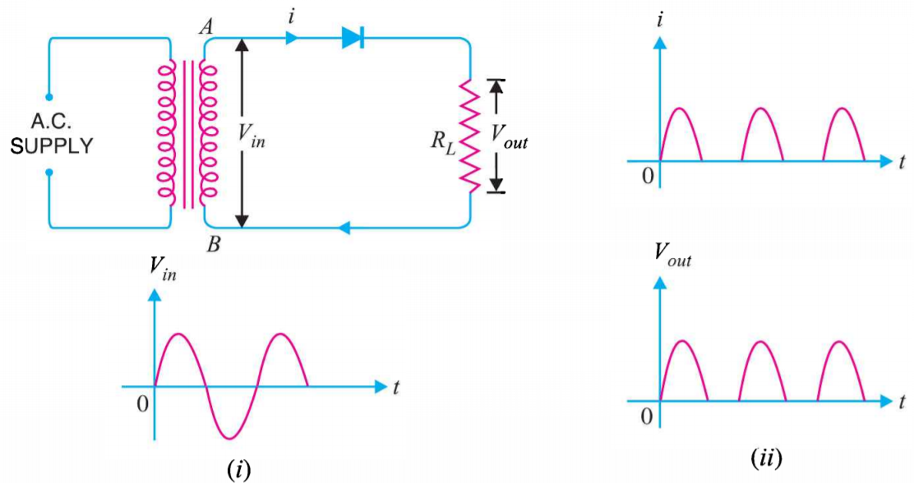
Half-wave rectifier
Circuit details and working mechanism:
The output across the load is pulsating d.c.

Slide 6
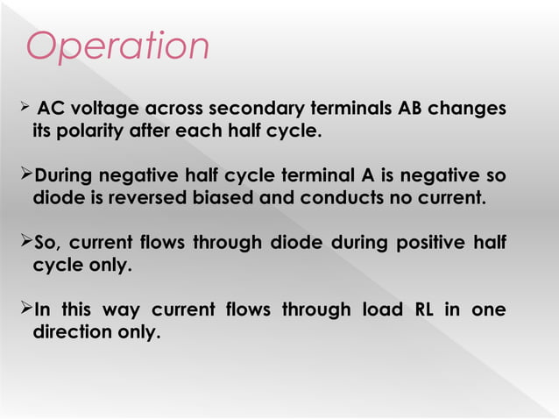
Operation

Slide 7
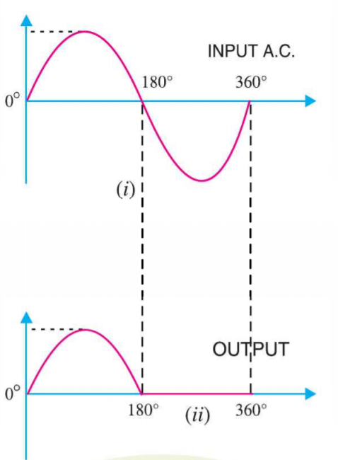

Output frequency of half-wave rectifier:
Frequency:
The number of waves that pass a given point in one second.
The output frequency of half-wave rectifier is equal to the input frequency .

Slide 8
Half Wave Rectifier Circuit Analysis

Slide 9
Half Wave Rectifier Circuit Analysis
Peak Inverse Voltage (PIV)
The peak inverse voltage is either the specified maximum voltage that a diode rectifier can block, or, alternatively, the maximum voltage that a rectifier needs to block in a given circuit.
PIV=Vs_{(max)}

Slide 10
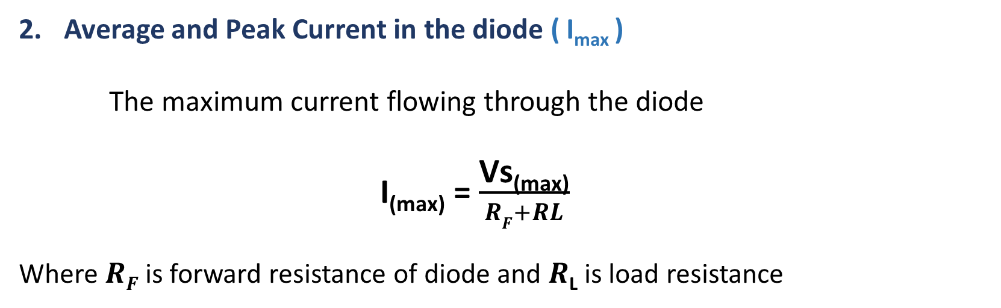
Half Wave Rectifier Circuit Analysis
Average and Peak Current in the diode ( I_{max} )
The maximum current flowing through the diode
I_{(max)} = $\frac{\text{Vs}\text{(}\text{max}\text{)}}{RF+RL}$
Where $RF$ is forward resistance of diode and $R\text{L}$ is load resistance

Slide 11
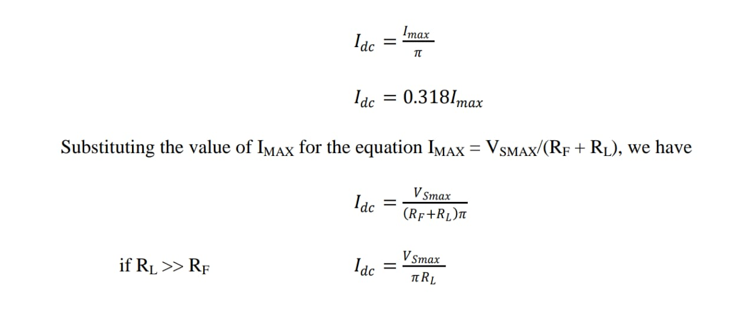
Half Wave Rectifier Circuit Analysis
3. DC output Current ( I_{DC} )
The DC output Current is given as

Slide 12
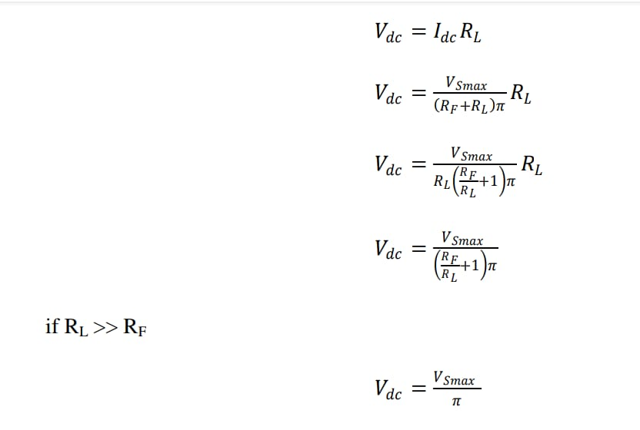
Half Wave Rectifier Circuit Analysis
4. DC output Voltage ( V_{DC} )
The DC output Voltage is given as

Slide 13
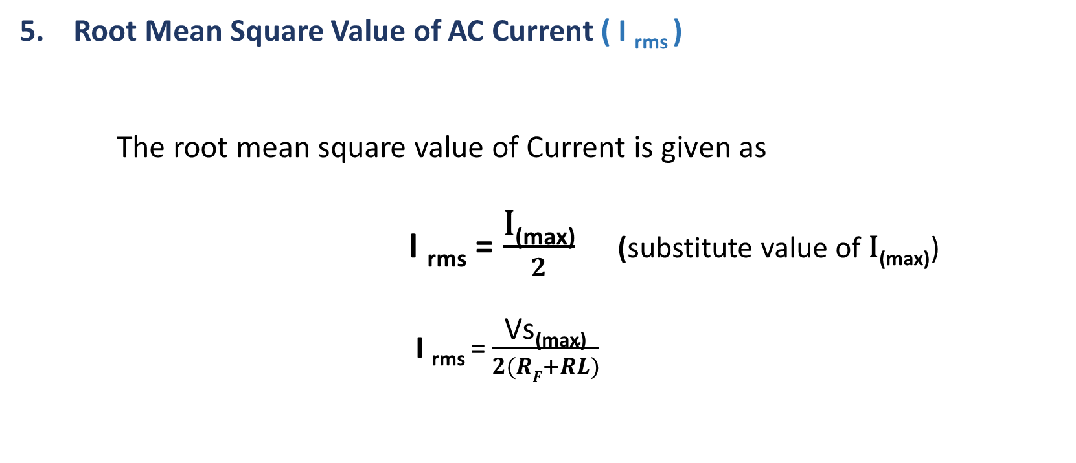
Half Wave Rectifier Circuit Analysis
5. Root Mean Square Value of AC Current ( I _{rms} )
The root mean square value of Current is given as
I _{rms} = $\frac{\text{I}\text{(}\text{max}\text{)}}{2}$ (substitute value of $\text{I}\text{(}\text{max}\text{)}$)
I _{rms} = $\frac{\text{Vs}\text{(}\text{max}\text{)}}{2(RF+RL)}$

Slide 14
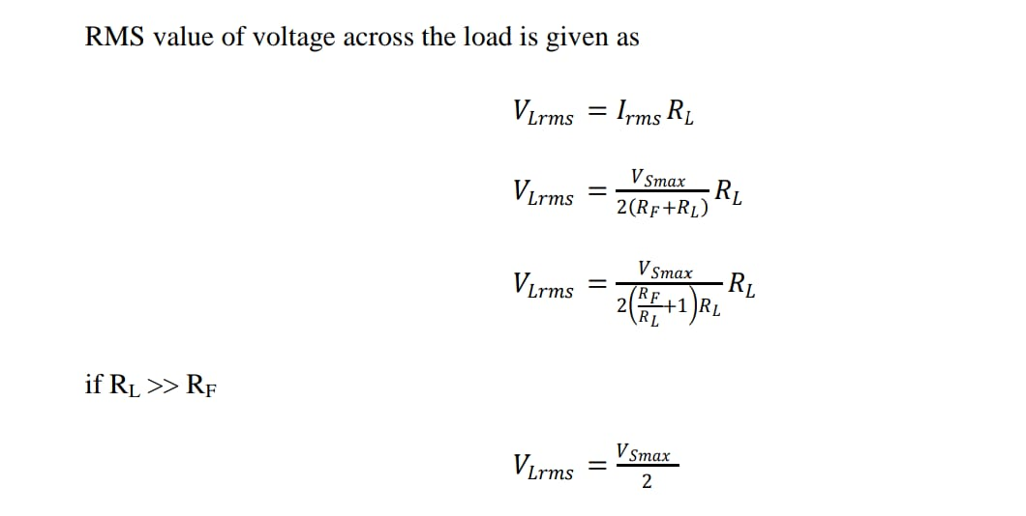
Half Wave Rectifier Circuit Analysis
6. Root Mean Square Value of Voltage across Load (V_{L(rms)} )

Slide 15

Efficiency of half-wave rectifier
Efficiency
The ratio of DC power output to the applied input AC power is known as rectifier efficiency i.e.

Slide 16
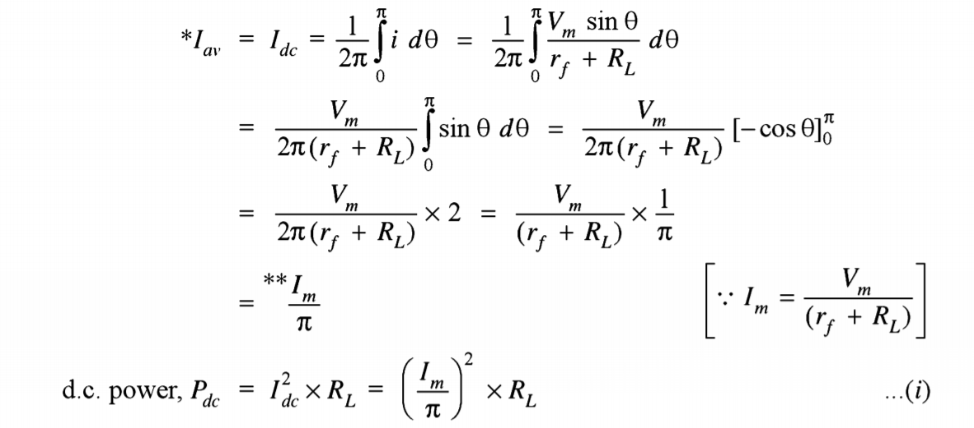
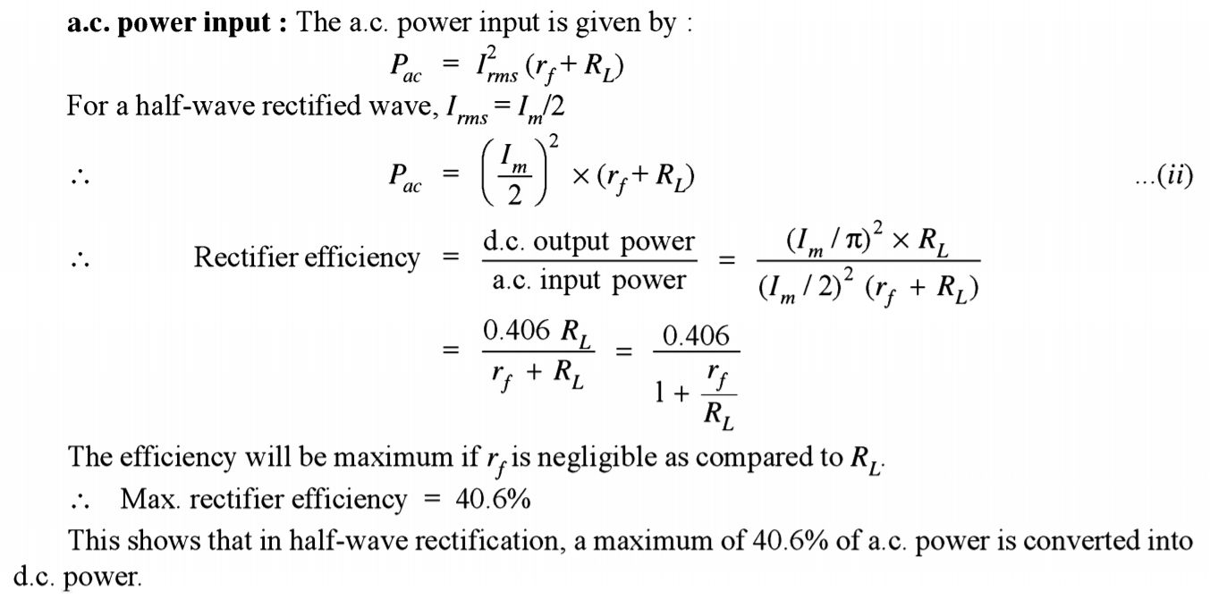
Efficiency of half-wave rectifier

Slide 17
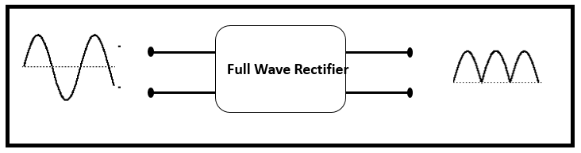
Full-wave rectifier
Full-wave rectifier: A rectifier that converts alternating current (AC) into direct current (DC) by allowing current flow through load in only one direction during both halves of the AC cycle.
It can be achieved with two diodes working alternatively, or a bridge rectifier, which uses four diodes arranged in a bridge configuration.
In full-wave rectifier, current flow towards load in the same direction for the both half cycles of input a.c. voltage
For positive half-cycle, one diode supplies current to load, for negative half cycle, second diode supplies current to load.

Slide 18
Two Diodes Full-wave rectifier (OR)
Center-Tap Full-Wave Rectifier
Circuit has two diodes D1, D2 and a center tap transformer.
During positive half cycle, Diode D1 conducts and during negative half cycle, Diode D2 conducts.
It can be seen that current through load RL is in the same direction for the both cycles.

Slide 19
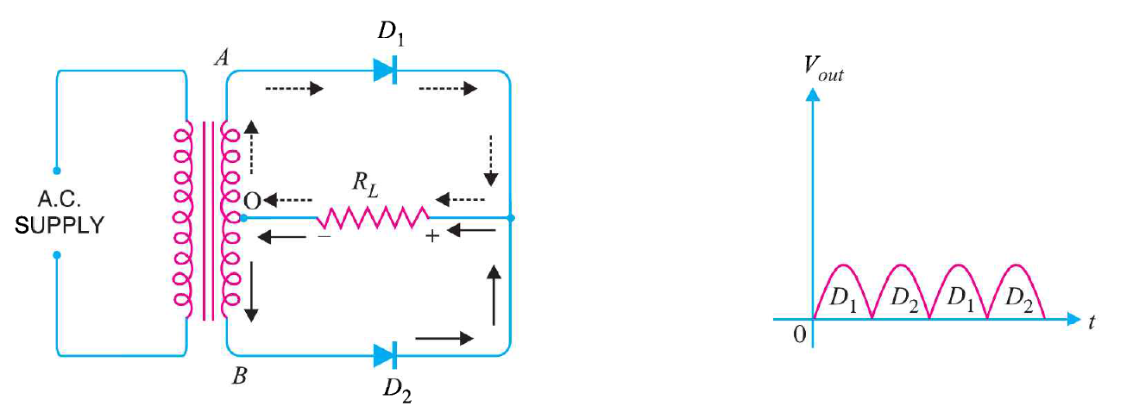
Two Diodes Full-wave rectifier Working Mechanism

Slide 20
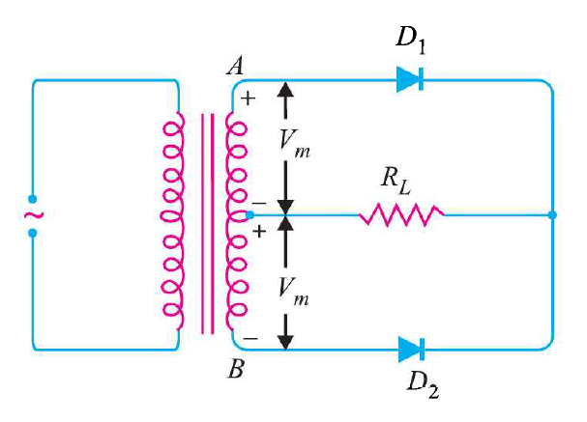
Full Wave Rectifier Circuit Analysis
Peak inverse voltage of center
tap rectifier (PIV)
PIV=2Vs_{(max)}

Slide 21
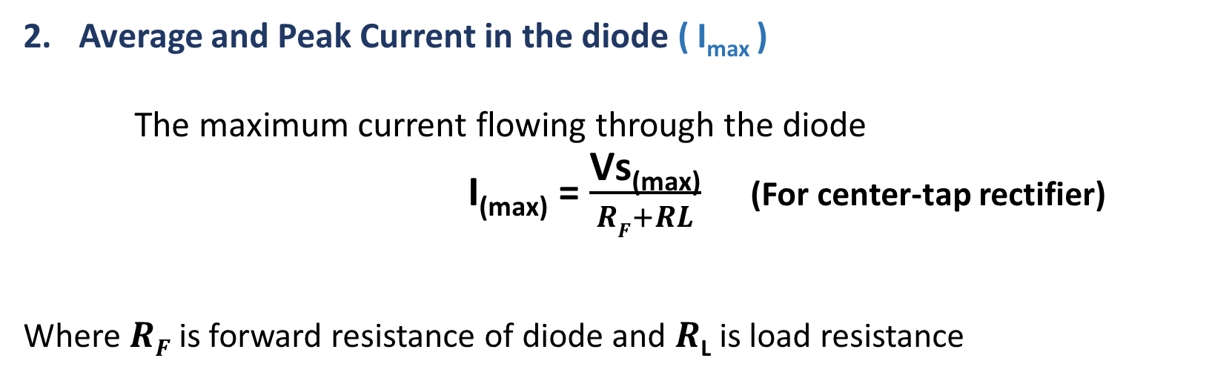
Full Wave Rectifier Circuit Analysis
Average and Peak Current in the diode ( I_{max} )
The maximum current flowing through the diode
I_{(max)} = $\frac{\text{Vs}\text{(}\text{max}\text{)}}{RF+RL}$ (For center-tap rectifier)
Where $RF$ is forward resistance of diode and $R\text{L}$ is load resistance

Slide 22

Full Wave Rectifier Circuit Analysis
3. DC output Current ( I_{DC} )
The DC output Current is given as
I_{(Dc)} =$\frac{\text{2} \text{I}\text{(}\text{max}\text{)}}{π}$
I_{(Dc)} =$\frac{\text{2} \text{V}\text{(}\text{max}\text{)}}{π(RF+RL)}$

Slide 23
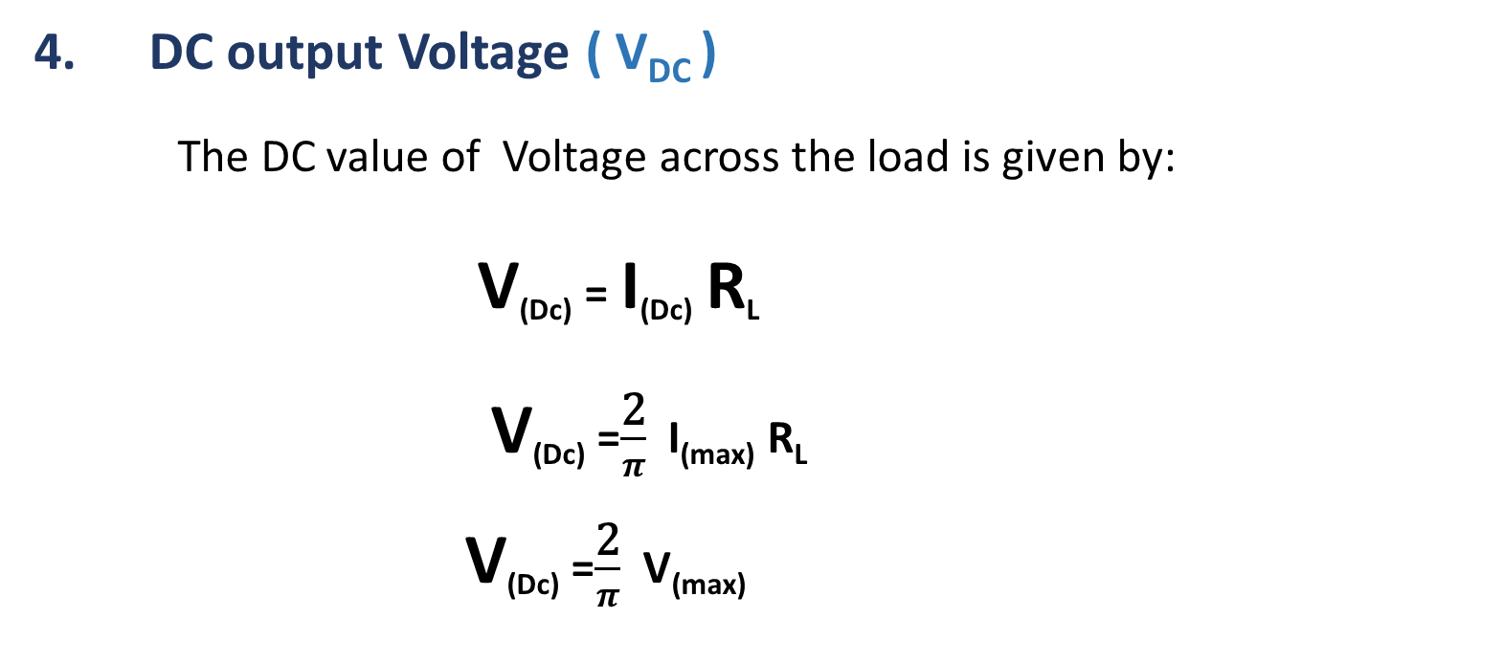
Full Wave Rectifier Circuit Analysis
4. DC output Voltage ( V_{DC} )
The DC value of Voltage across the load is given by:
V_{(Dc)} = I_{(Dc)} R_{L}
V_{(Dc)} =$\frac{\text{2}}{π}$ I_{(max)} R_{L}
V_{(Dc)} =$\frac{\text{2}}{π}$ V_{(max)}

Slide 24
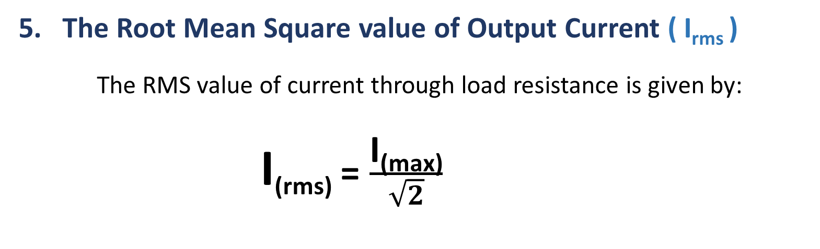
Full Wave Rectifier Circuit Analysis
5. The Root Mean Square value of Output Current ( I_{rms} )
The RMS value of current through load resistance is given by:
I_{(rms)} = $\frac{\text{I}\text{(}\text{max}\text{)}}{\sqrt{2}}$

Slide 25
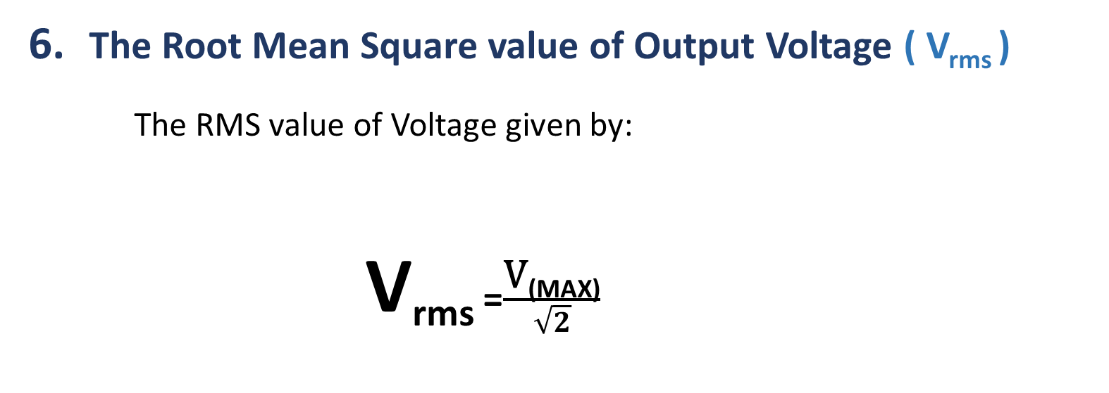
Full Wave Rectifier Circuit Analysis
6. The Root Mean Square value of Output Voltage ( V_{rms} )
The RMS value of Voltage given by:
V_{rms} =$\frac{\text{V}\text{(}\text{MAX}\text{)}}{\sqrt{2}}$

Slide 26
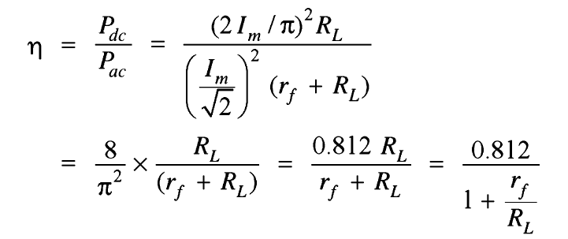
Full-wave rectifier
Efficiency:
Consider r_{f} is negligible as compare to R_{L}
Max. efficiency = 81.2%

Slide 27
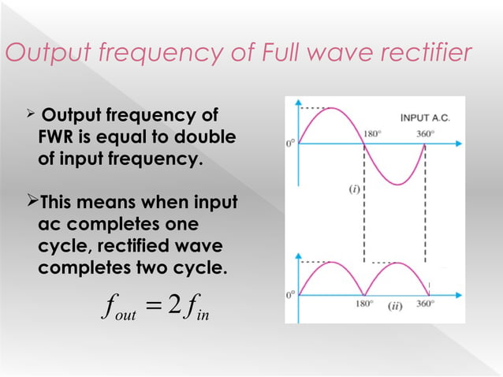
Output frequency of Full wave rectifier

Slide 28
Bridge Diode Full-wave rectifier
In Bridge rectifier, four diodes are arranged in the form of a bridge.
The main advantage of this bridge circuit is that it does not require a special center tapped transformer.
The single secondary winding is connected to one side of the diode bridge network and the load to the other side.
This configuration provides same polarity output with either polarity.
The output is twice that of the center tap circuit for the same secondary voltage.
The PIV is one half that of the center-tap circuit.

Slide 29
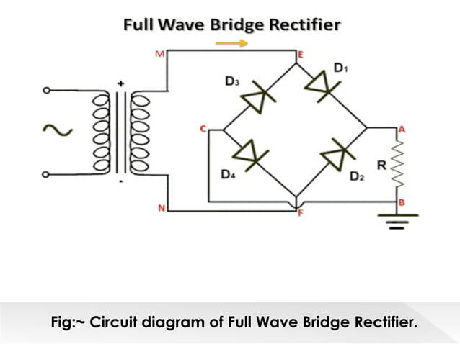
Bridge Diode Full-wave rectifier

Slide 30
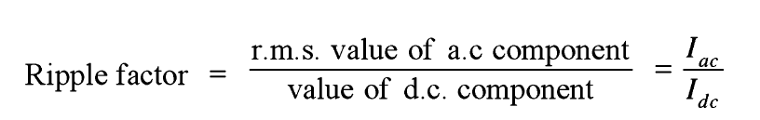
Ripple Factor
Ripple Factor
    The output current contains both AC and DC components . The ripple factor measures the percentage of AC component in the rectified output.
“The ratio of r.m.s. value of a.c. component to the d.c. component in the rectifier output is known as the ripple factor.”

Slide 31
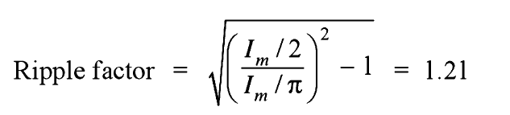
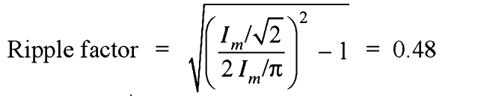
Ripple Factor
Mathematical analysis:
For Half wave rectification:
For Full wave rectification:

Slide 32
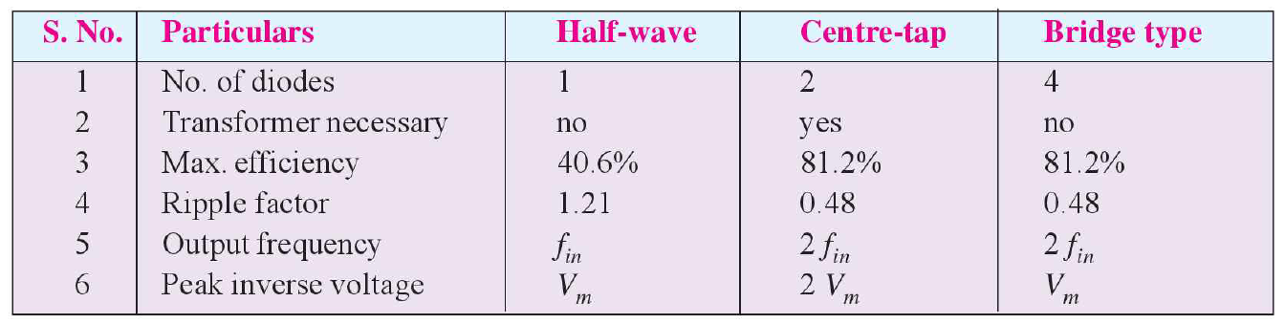
Comparison of rectifiers

Slide 33


Any Question

